Slide 1


Department of BES-I
COURSE: Data Structures
COURSE CODE: 24SC1204
Topic:
Name of the topic:
Singly Linked List
Session – 9

Slide 2



AIM OF THE SESSION
To familiarize students with the basic concept of Singly linked list
INSTRUCTIONAL OBJECTIVES
This Session is designed to:
Demonstrate The Singly linked list
Describe the types of Singly linked list.
List out the operations possible on the Singly linked list.
Describe each operation
List out the advantages and applications of SLL.
LEARNING OUTCOMES
At the end of this session, you should be able to:
Define Singly linked list
Describe two types of Singly linked list. And their operations
Summarize definition, types and operations of circular linked list and its applications

Slide 3
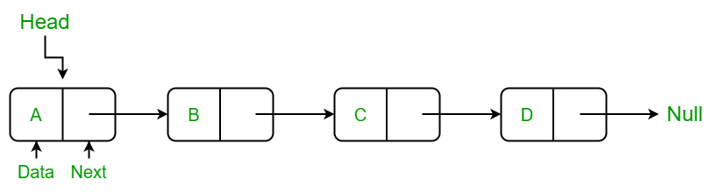
Singly Linked List
INTRODUCTION
A singly linked list is a linear data structure in which the elements are not stored in contiguous memory locations.
Each element is connected only to its next element using a pointer.
Every node points to its next node in the sequence and the last node points NULL.

Slide 4
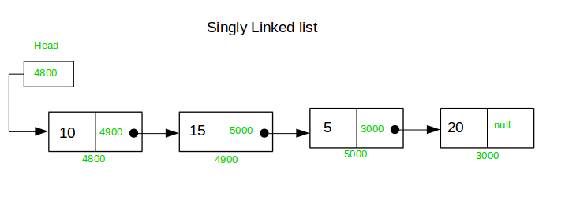
Example of Singly Linked list with 4 nodes

Slide 5
OPERATIONS ON SINGLY LINKED LIST
In a singly linked list, we can perform the following operations...
  Insertion
  Deletion
  Display
1. Insertion:
  i) Insertion At Beginning of the SLL
  ii) Insertion At End of the SLL
  iii) Insertion At Specific location in the SLL
2. Deletion:
  i) Deletion At Beginning of the SLL
  ii) Deletion At End of the SLL
  iii) Deletion At Specific location in the SLL

Slide 6
Setup the Singly Linked List
Before we implement those operations, first we need to setup empty list.
Perform the following steps to setup Empty SLL:.
Step 1 - Define a Node structure with two members/fields data and next
Step 2 - Define a Node pointer 'head' and set it to NULL.
Step 3 – Then perform the Operations one by one.
The node is defined (represented) as:
class Node:
def __init__(self, data):
self.data = data # Stores the value
self.next = None # Points to the next node (initially None)
class LinkedList:
def __init__(self):
self.head = None # Points to the first node (initially None)

Slide 7
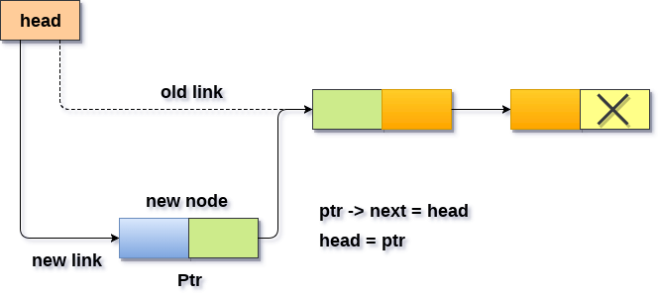
i) Insertion At Beginning of the SLL
It involves inserting any element at the front of the list. We just need to a few link adjustments to make the new node as the head of the list.

Slide 8
i) Insertion At Beginning of the SLL
We can insert a new node at beginning(before head node) of the Singly linked list.
Algorithm:
Step 1: IF PTR = NULL
Write OVERFLOW
Go to Step 7
[END OF IF]
Step 2: SET NEW_NODE = PTR
Step 3: SET PTR = PTR → NEXT
Step 4: SET NEW_NODE → DATA = VAL
Step 5: SET NEW_NODE → NEXT = HEAD
Step 6: SET HEAD = NEW_NODE
Step 7: EXIT

Slide 9
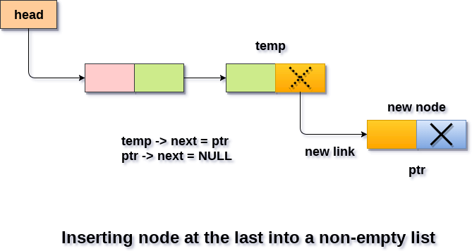
ii) Insertion At End of the SLL
It involves insertion at the last of the linked list. The new node can be inserted as the only node in the list or it can be inserted as the last one. Different logics are implemented in each scenario.

Slide 10
ii) Insertion At End of the SLL
We can insert a new node at end(after tail/null node) of the singly linked list.
Algorithm:
Step 1: IF PTR = NULL Write OVERFLOW
Go to Step 1
[END OF IF]
Step 2: SET NEW_NODE = PTR
Step 3: SET PTR = PTR - > NEXT
Step 4: SET NEW_NODE - > DATA = VAL
Step 5: SET NEW_NODE - > NEXT = NULL
Step 6: SET PTR = HEAD
Step 7: Repeat Step 8 while PTR - > NEXT != NULL
Step 8: SET PTR = PTR - > NEXT
[END OF LOOP]
Step 9: SET PTR - > NEXT = NEW_NODE
Step 10: EXIT

Slide 11
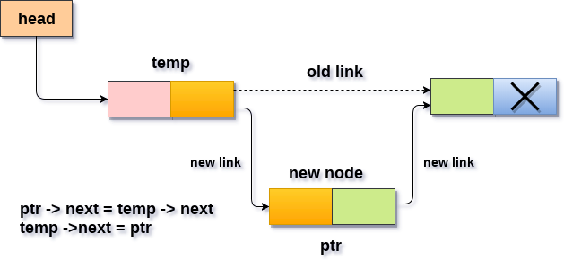
iii) Insertion At Specific location in the SLL
It involves insertion after the specified node of the linked list. We need to skip the desired number of nodes in order to reach the node after which the new node will be inserted.

Slide 12
iii) Insertion At Specific location of the SLL
Algorithm:
STEP 1: IF PTR = NULL
WRITE OVERFLOW
GOTO STEP 12
END OF IF
STEP 2: SET NEW_NODE = PTR
STEP 3: NEW_NODE → DATA = VAL
STEP 4: SET TEMP = HEAD
STEP 5: SET I = 0
STEP 6: REPEAT STEP 5 AND 6 UNTIL I
STEP 7: TEMP = TEMP → NEXT
STEP 8: IF TEMP = NULL
WRITE "DESIRED NODE NOT PRESENT"
GOTO STEP 12
END OF IF
END OF LOOP
STEP 9: PTR → NEXT = TEMP → NEXT
STEP 10: TEMP → NEXT = PTR
STEP 11: SET PTR = NEW_NODE
STEP 12: EXIT

Slide 13
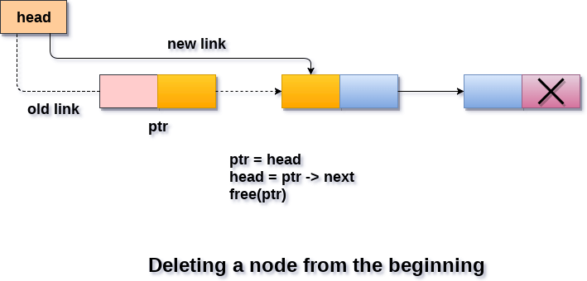
i) Deletion At Beginning of the SLL
It involves deletion of a node from the beginning of the list. This is the simplest operation among all. It just need a few adjustments in the node pointers.

Slide 14
i) Deletion At Beginning of the SLL
We can delete a node from the beginning of the list.
Algorithm:
Step 1: IF HEAD = NULL
Write UNDERFLOW
Go to Step 5
[END OF IF]
Step 2: SET PTR = HEAD
Step 3: SET HEAD = HEAD -> NEXT
Step 4: FREE PTR
Step 5: EXIT

Slide 15
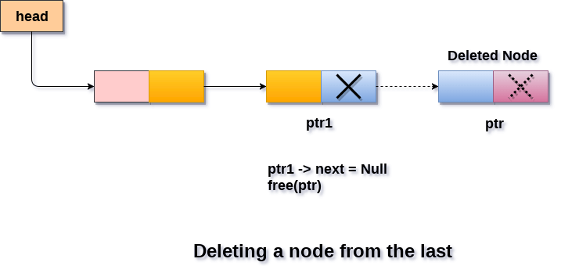
ii) Deletion At End of the SLL
It involves deleting the last node of the list. The list can either be empty or full. Different logic is implemented for the different scenarios.

Slide 16
ii) Deletion At End of the SLL
We can delete a node at end of the singly linked list.
Algorithm:
Step 1: IF HEAD = NULL
Write UNDERFLOW
Go to Step 8
[END OF IF]
Step 2: SET PTR = HEAD
Step 3: Repeat Steps 4 and 5 while PTR -> NEXT!= NULL
Step 4: SET PREPTR = PTR
Step 5: SET PTR = PTR -> NEXT
[END OF LOOP]
Step 6: SET PREPTR -> NEXT = NULL
Step 7: FREE PTR
Step 8: EXIT

Slide 17
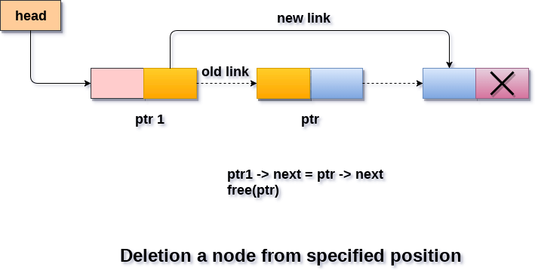
iii) Deletion At Specific location in the SLL
It involves deleting the node after the specified node in the list. we need to skip the desired number of nodes to reach the node after which the node will be deleted. This requires traversing through the list.

Slide 18
iii) Deletion At Specific location of the SLL
Algorithm:
STEP 1: IF HEAD = NULL
WRITE UNDERFLOW
GOTO STEP 10
END OF IF
STEP 2: SET TEMP = HEAD
STEP 3: SET I = 0
STEP 4: REPEAT STEP 5 TO 8 UNTIL I
STEP 5: TEMP1 = TEMP
STEP 6: TEMP = TEMP → NEXT
STEP 7: IF TEMP = NULL
WRITE "DESIRED NODE NOT PRESENT"
GOTO STEP 12
END OF IF
STEP 8: I = I+1
END OF LOOP
STEP 9: TEMP1 → NEXT = TEMP → NEXT
STEP 10: FREE TEMP
STEP 11: EXIT

Slide 19
Display Operation in Singly Linked List
We can use the following steps to display the elements of a single linked list
Algorithm:
Step 1 - Check whether list is Empty (head == NULL)
Step 2 - If it is Empty then, display 'List is Empty!!!' and terminate the function.
Step 3 - If it is Not Empty then, define a Node pointer 'temp' and initialize with head.
Step 4 - Keep displaying temp → data with an arrow (--->) until temp reaches to the last node
Step 5 - Finally display temp → data with arrow pointing to NULL (temp → data ---> NULL).

Slide 20
THANK YOU
Team – Data Structures

